Slide 1
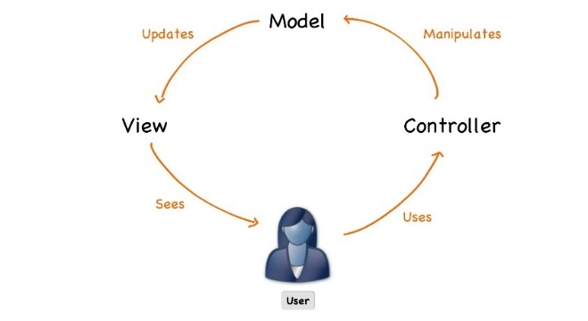



C# Web Basics
Course Introduction
SoftUni Team
Technical Trainers
Software University
https://softuni.bg

Slide 2
Table of Contents
Course Objectives
Training and Team
Course Organization
Course Infrastructure
Evaluation Criteria

Slide 3
Have a Question?
sli.do
#csharp-web

Slide 4











SoftUni Diamond Partners

Slide 5



Educational Partners

Slide 6

Course Objectives

Slide 7
C# Web Basics
Web Fundamentals
HTTP Protocol
Custom Web Server
Custom MVC Framework
Custom View Engine
7

Slide 8
ASP.NET Core
Essentials of ASP.NET Core
Razor View Engine
Security and Identity
Project Architecture
Unit Testing
Control Flow
Deployment and Continuous Integration
8

Slide 9
Practical Programming Exam
1 practical problem for 4 hours
Implementing a simple web application with:
Custom MVC
Part of the of Views
Solutions are evaluated by hand after the exam
9

Slide 10
Theoretical Exam
You will have 30 minutes once you enter
Multiple-choice with 1 or more correct answers
English
Automated quiz system
Available during the practical exam and 30 minutes after it
You can submit your answers just one time
Advice: Start it when you finish the practical exam
10

Slide 11

Trainers

Slide 12

Ivaylo Kenov
Various job titles at the same time:
CTO @ SoftUni Dev Team
Technical Trainer @ SoftUni
Creator of open-source libraries for ASP.NET
MyTested.AspNetCore.Mvc
Mathematical competitions champion
Contacts:
https://github.com/ivaylokenov
https://linkedin.com/in/kenov

Slide 13

Course Organization

Slide 14
C# Web Course - Timeline
18-May-2021
26-June-2021
24-Aug-2021
C# Web Basics
5 weeks * 2 times / week
12 credits
Start: 18-May-2021
Exam: 26-June-2021
Theoretical Exam: 26-June-2021
Re-Take Exams: 24-Aug-2021

Slide 15

Course Workflow
Live coding
You no longer have homework
Fix bugs and implement features in the custom MVC framework
Work with github
Groups of lectures are followed by workshops
Knowledge is used to extend an application
Best practices are applied

Slide 16


SoftUni Certificate
Practical Exam 100%
Homework 5%
Evaluation
16

Slide 17
CPE Certificate
Practical Exam
Theoretical Exam
Evaluation
17

Slide 18



Course Web Site, Forum and FB Group
Official web site:
Official discussion forum:
Official Facebook groups:
https://softuni.bg/trainings/3353/csharp-web-basics-basics-may-2021
https://softuni.bg/forum/categories/66/csharp-web-development-basics
https://www.facebook.com/groups/CsharpWebMay2021

Slide 19
Questions?
Notes:
19

Slide 20
Trainings @ Software University (SoftUni)
Software University – High-Quality Education, Profession and Job for Software Developers
softuni.bg, about.softuni.bg
Software University Foundation
softuni.foundation
Software University @ Facebook
facebook.com/SoftwareUniversity
Software University Forums
forum.softuni.bg
20
Notes:
20

Slide 21

License
This course (slides, examples, demos, exercises, homework, documents, videos and other assets) is copyrighted content
Unauthorized copy, reproduction or use is illegal
© SoftUni – https://about.softuni.bg
© Software University – https://softuni.bg
Notes:
21

